Slide 1
Plasma Diagnostic Techniques Optical Emission Spectroscopy Lecture 5
Deborah O’Connell
York Plasma Institute

Slide 2
Corona model: Summary so far

Slide 3
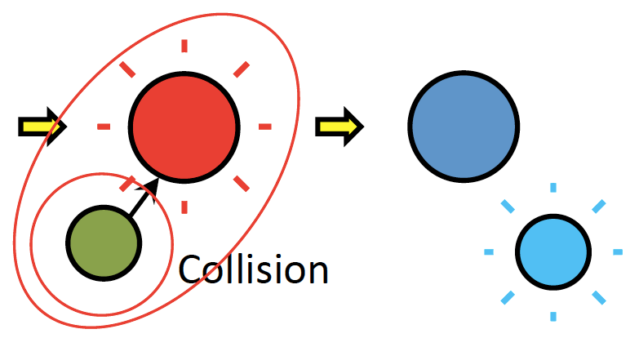
Corona: collisional de-excitation
collisional de-excitation (quenching)
A* + Q ?
- particularly important at high pressures!
$\frac{dn_{i}}{dt}=n_{0}E_{i}+n_{m}E_{i,m} −$ $n_{i}\sum_{k}{A_{i,k}−n_{i}\sum_{q}{{n_{q}k}_{q}} }$
k_{q} : quenching coefficient with species Q
n_{q} : density of species Q

Slide 4
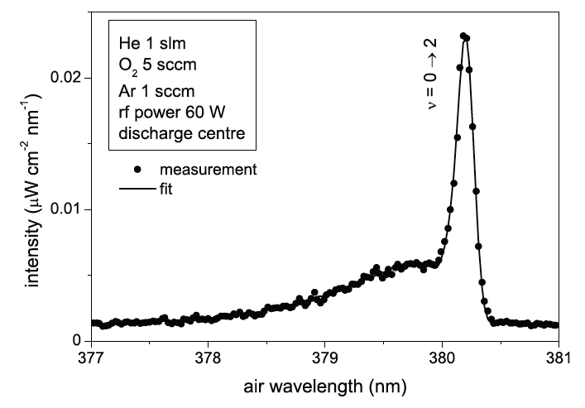
Corona: collisional de-excitation
: quenching cross-section, T_{gas} indepedent
T_{gas} : gas temperature
<v> : mean velocity
: reduced mass
Importance of T_{gas}
Which quenching partners are present?
What are the densities?

Slide 5
Corona – additional processes…
Electron impact excitation out of the electronic ground state
Radiative relaxation through spontaneous emission
Additional processes:
Population through cascading processes from higher excited states
Step-wise excitation through electron impact out of lower metastable states
Collisional de-excitation (quenching)
Complex collisional-radiative models are often required to describe specific non-equilibrium plasma conditions. This is an active entire research field!

Slide 6
Which emission line should I analyse?
selection rules for emission lines
good quality of electron impact excitation cross-sections (same source!)
negligible excitation out of metastables
small cascade contribution
short lifetimes
competition with quenching
high intensities
high temporal resolution
known quenching coefficient (better small)
no excitation transfer with other species
no spectral overlap with other emission

